Slide 1


Multi-Displicine Project based Internet of Things and Artificial Intelligence
LÊ TRỌNG NHÂN
trongnhanle@hcmut.edu.vn
trongnhanle85@gmail.com

Slide 2
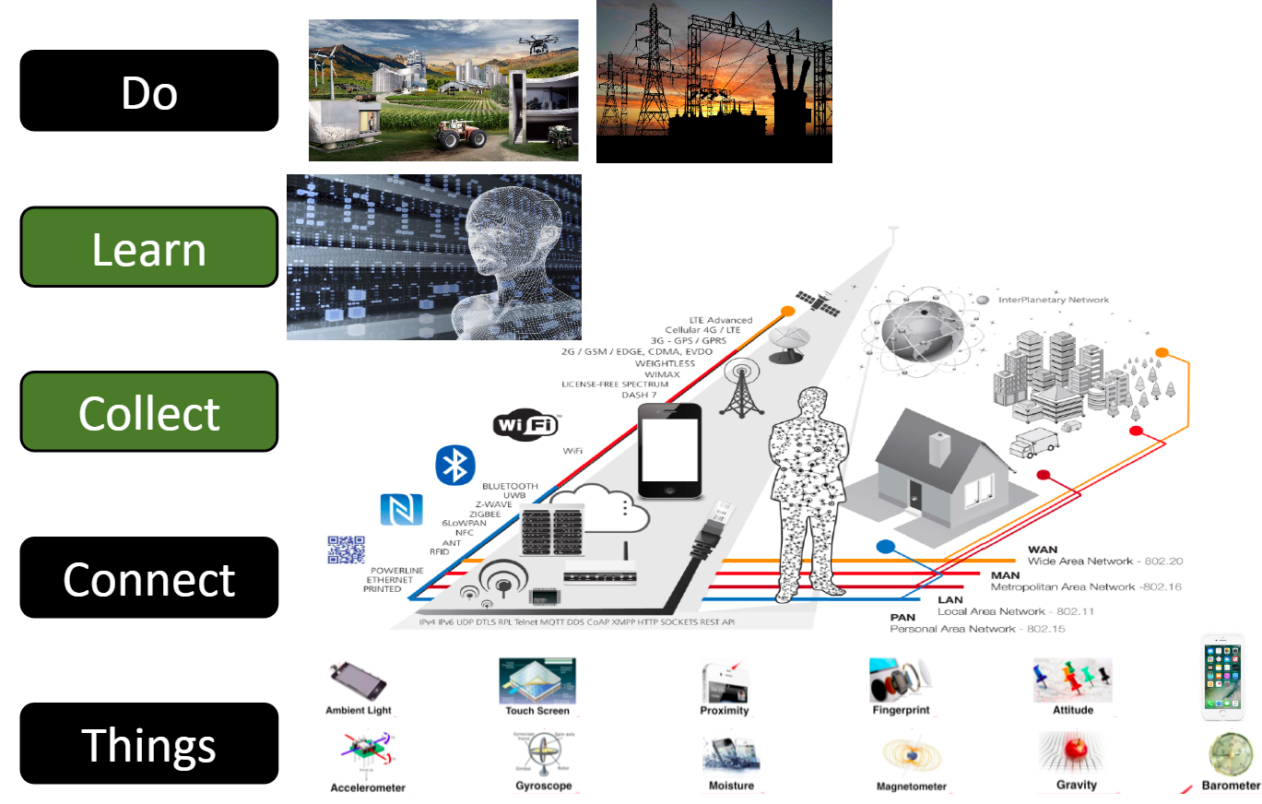
Industrial 4.0 Architecture
Proposed by Timothy Chou

Slide 3
Project Block Function
AI Camera based on Google Teachable Machine
IoT Server for Remote monitoring and Controlling (Adafruit IO)
Data Analytics or ChatBot
Simple Sensors (Temperature and Humidity) and Actuators (Pump and LEDs)
Dashboard (Website or Mobile App)

Slide 4
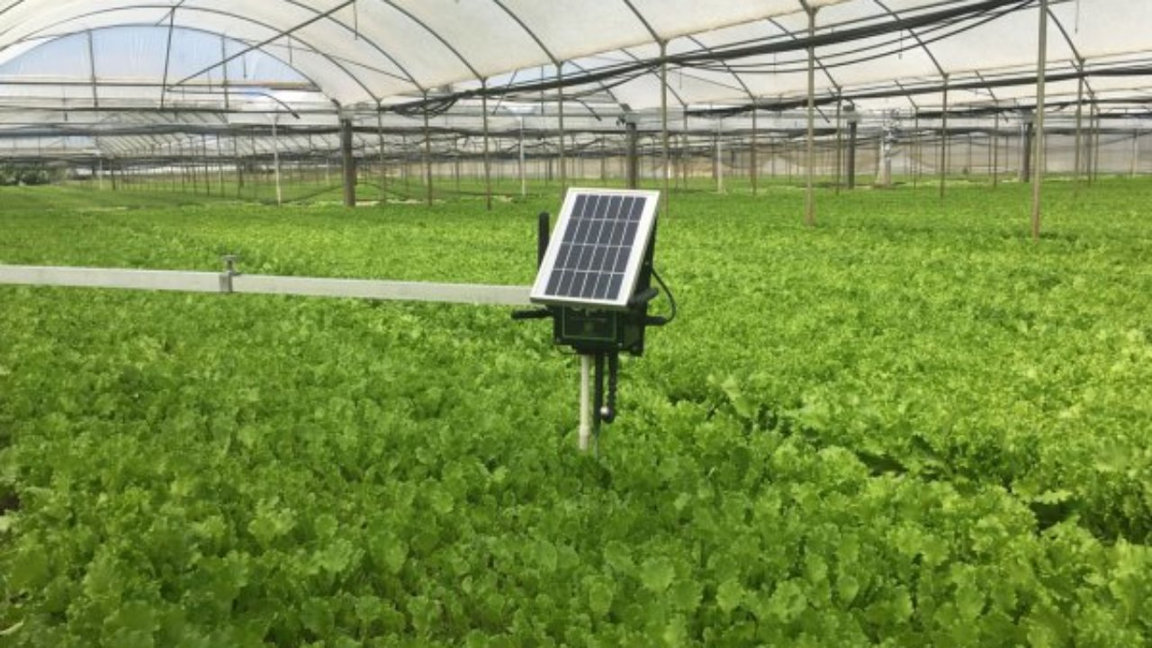
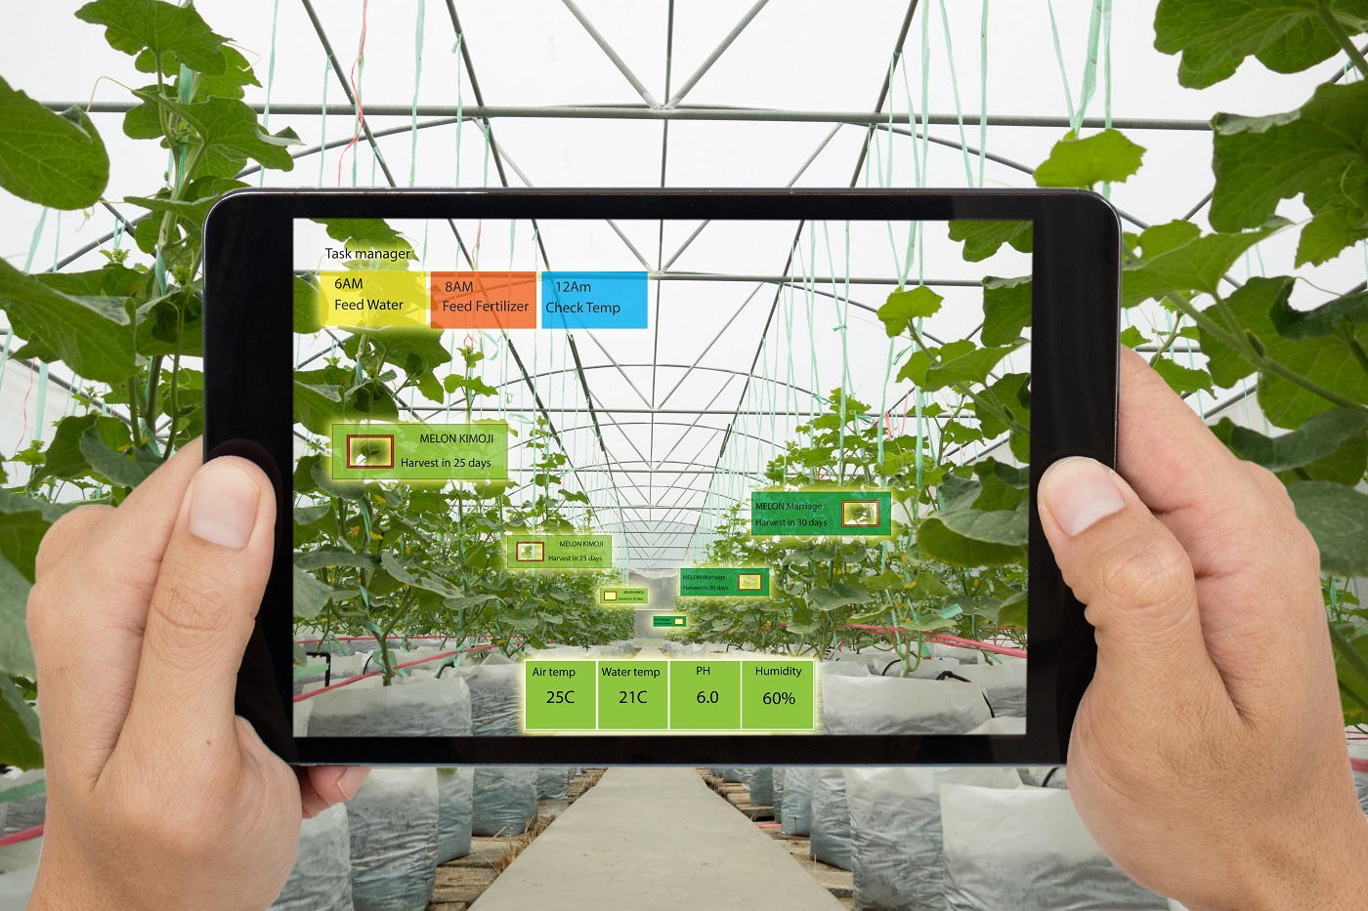
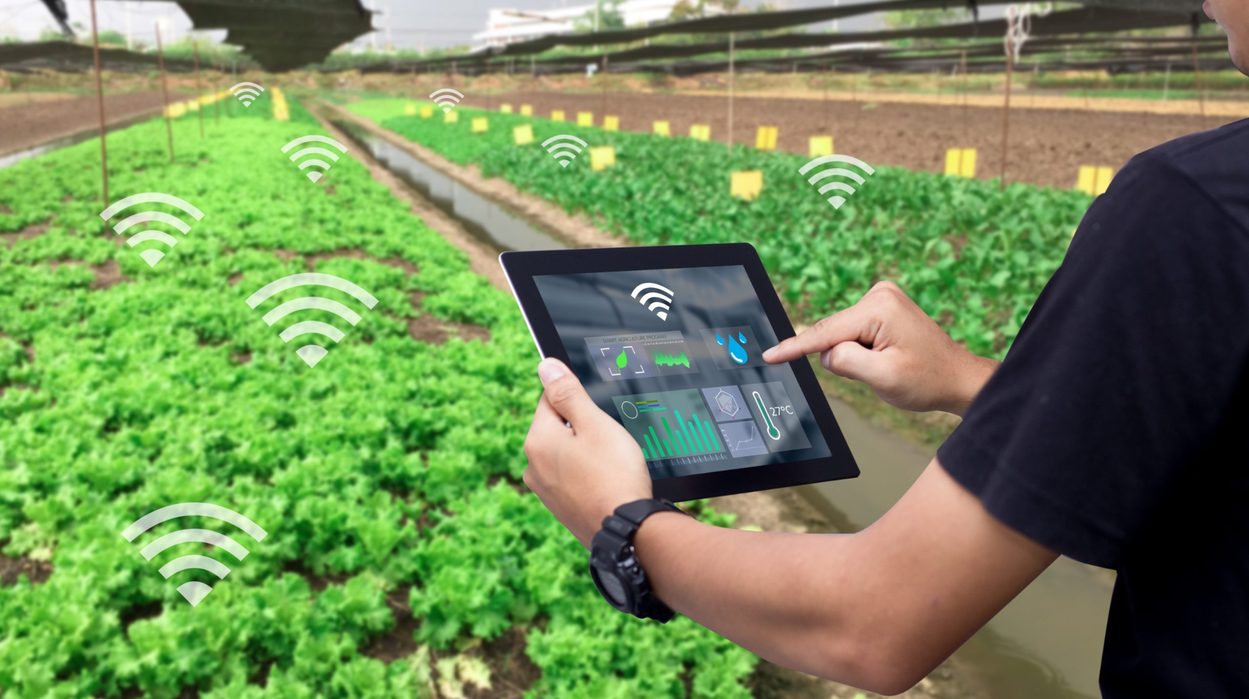
Smart Agriculture
Temperature and Humidity
pH, EC
Light intensity
Pump controllers

Slide 5
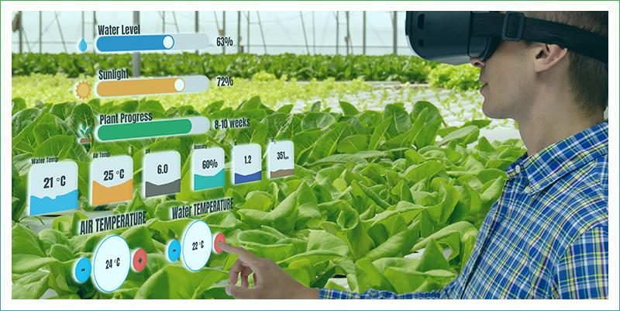
Monitoring System based AR/VR

Slide 6
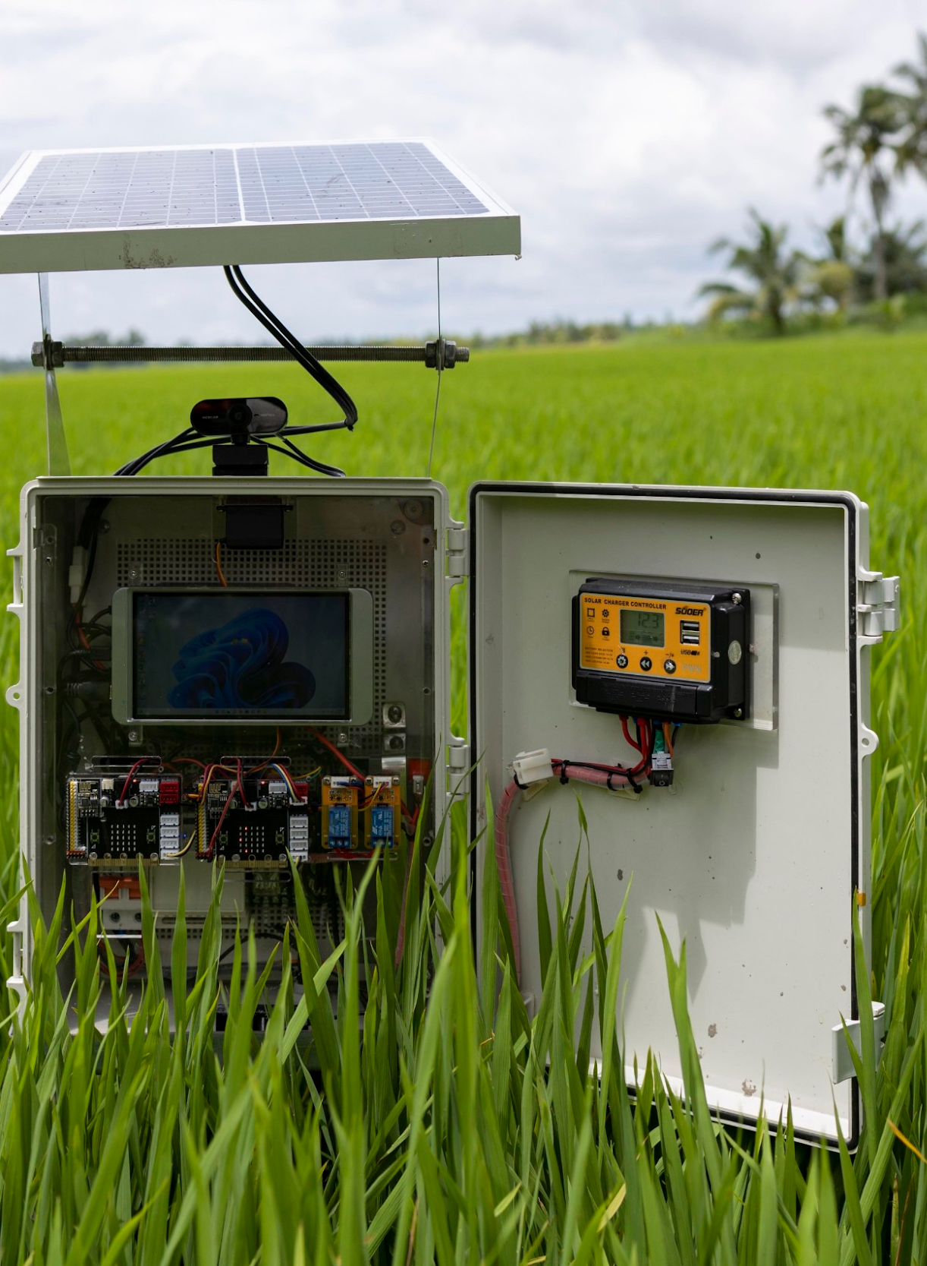
Project Introduction
AI inference using webcam (2p)
Remote monitoring through IoTs service (4p)
Simple hardware devices (supported Hardware Abstraction Layer) (2p)
Data analytics or ChatBot (2p)
Extra features (maximum 2p)
Group of 5 – 7 students

Slide 7
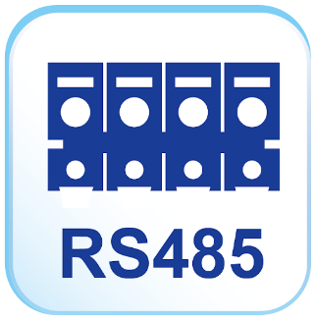
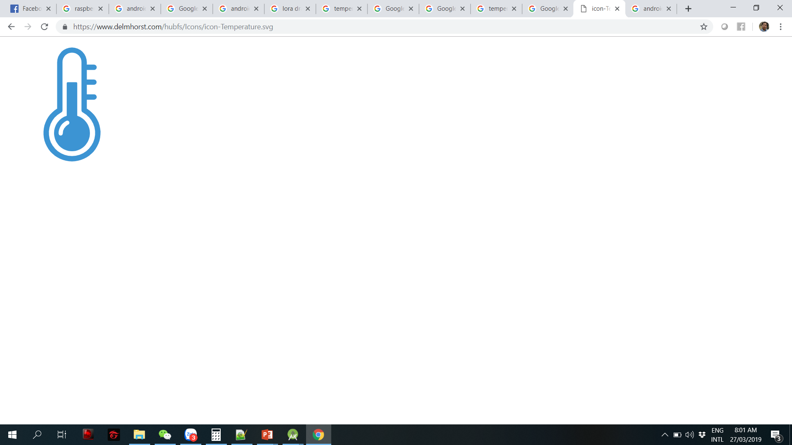

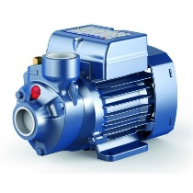

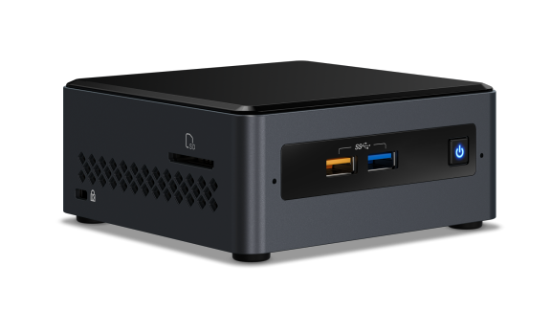
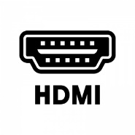
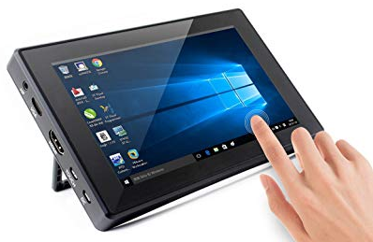



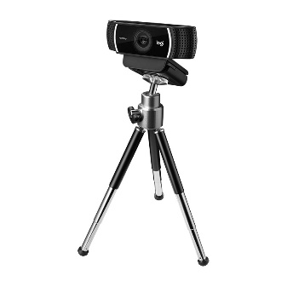
Generic AI and IoTs Architecture
…
Slave #1
Slave #2
Slave #40
Touch Screen LCD

Slide 8
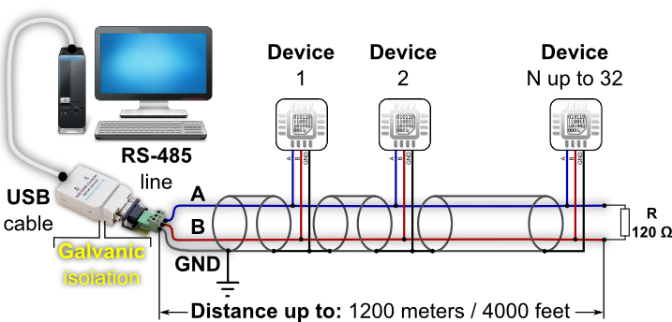
Sensors and Actuators
Physical hardware of the project
Control by RS485 connection:
Python program sends a command
Data is response in an array (8 bytes)

Slide 9
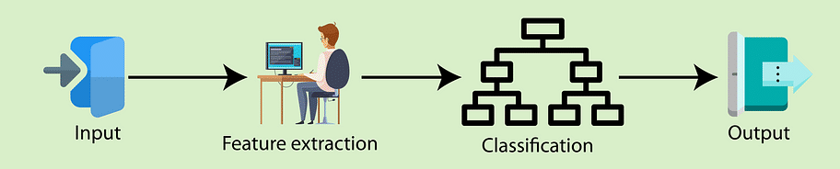
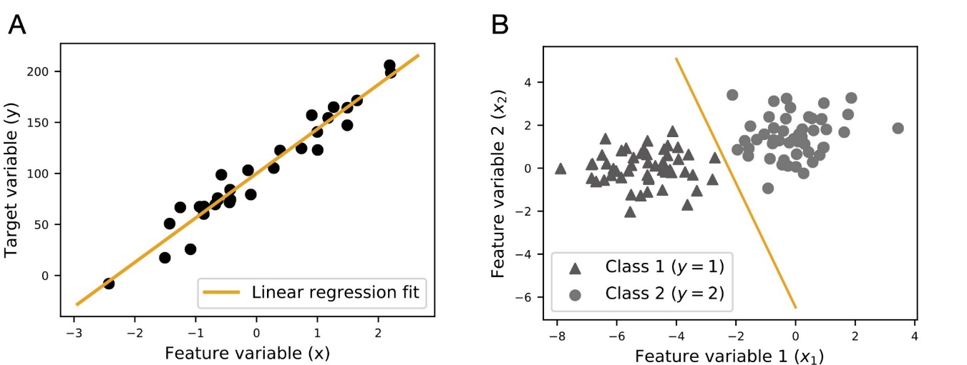
Google Teachable Machine for AI
Classification — The output variable is a category, such as “red” or “blue” or “disease” or “no disease”

Slide 10
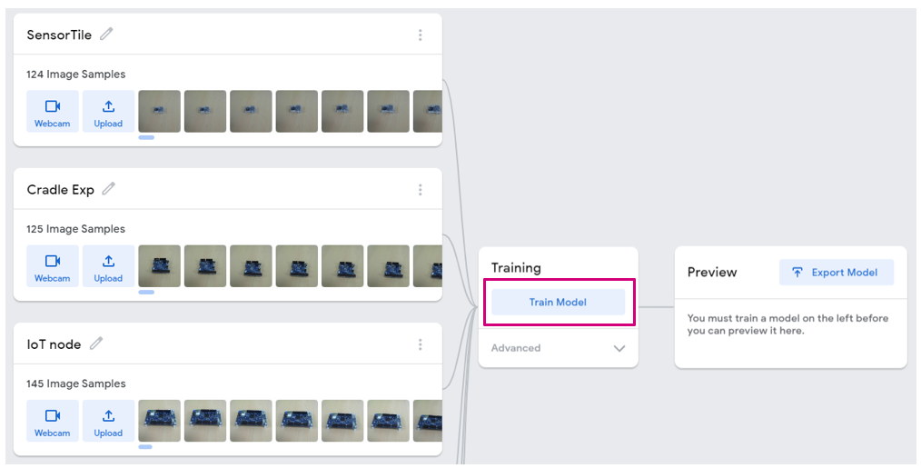
Training the Model
More options can be changed in the Advanced

Slide 11
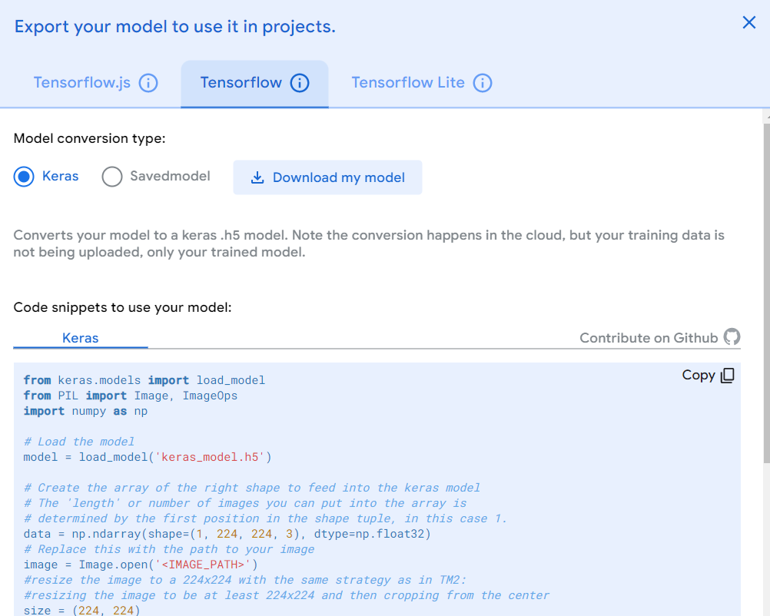
Export the Model
Tensorflow – Keras and Download my model

Slide 12
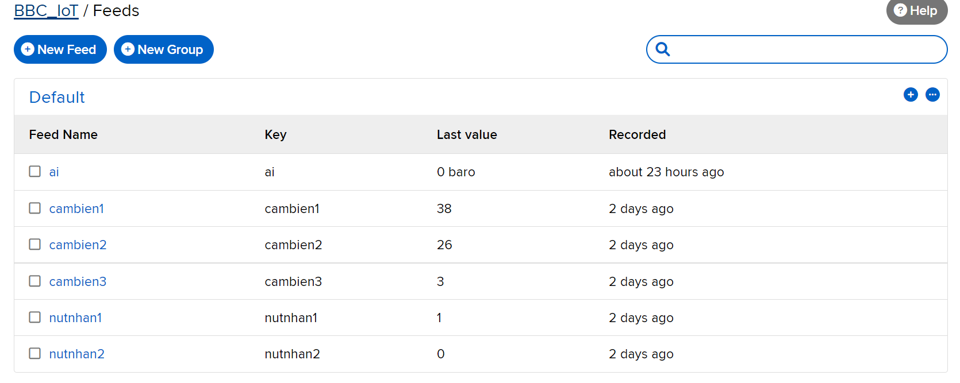
IoT Server using Adafruit IO
Free server with 60 messages/min
Support MQTT Pub/Sub, HTTP, HTTPs
Email for the Alarms

Slide 13
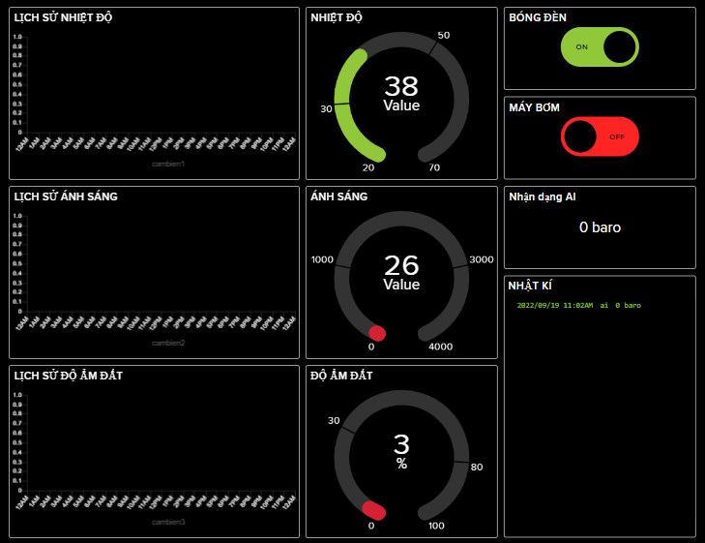
Dashboard for Remote Monitoring
Web or Mobile version is encouraged
Dashboard on Adafruit IO is an option

Slide 14
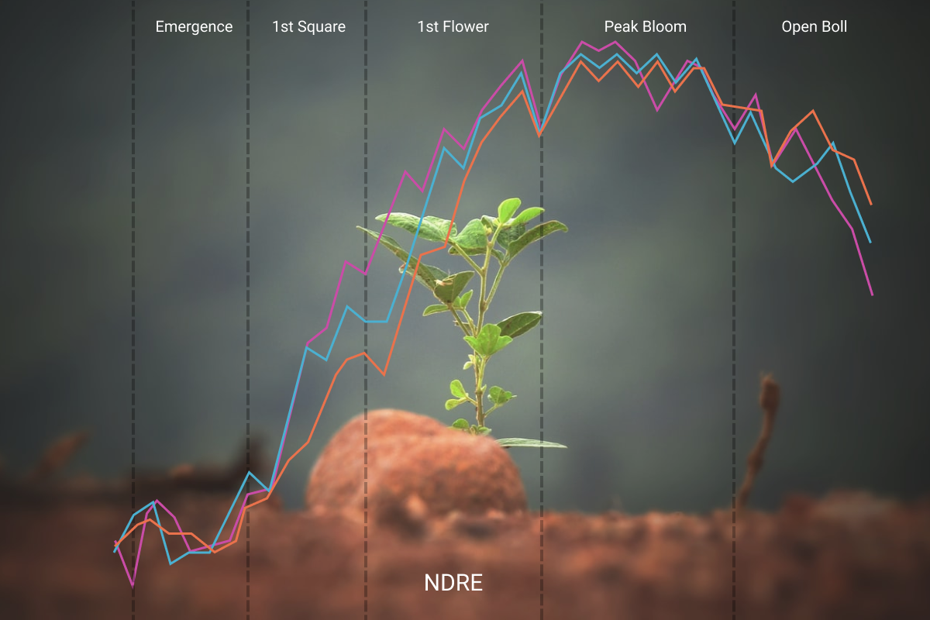
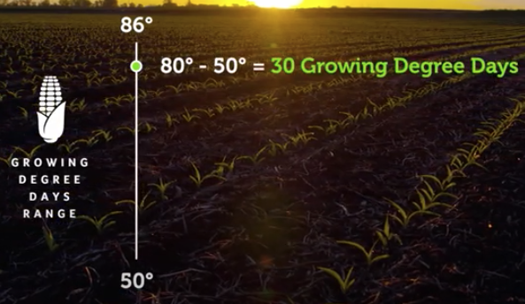
Data Analytics
Growing degree days (GDD) is a weather-based indicator for assessing crop development.
It is a function of many sensors: light, humidity, v.v…
A simple function is proposed for this feature
GDD is published to the IoT server as an additional information (or an advanced sensor)

Slide 15
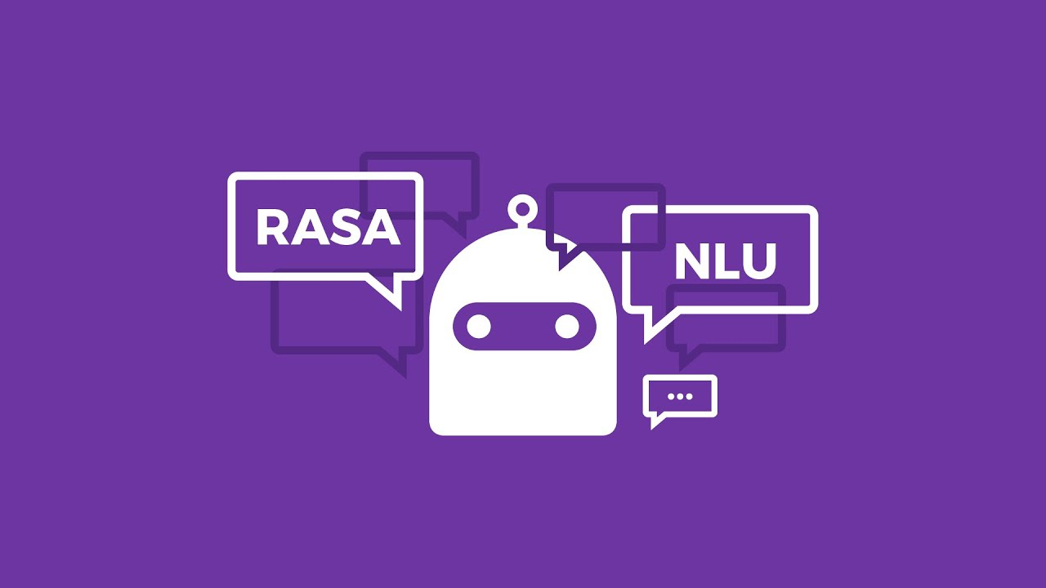
ChatBot
Rasa Framework
ChatGPT???
Voice activation controller

Slide 16
Extra functions
Proposed by students:
Data predictions for weather forecast

Slide 17
Project Plan
Project Functions | Week No
Build an AI Model | 1
Adafruit IO Server | 2
Data analytics and ChatBot | 3
Simple sensors and actuator | 4
Project Proposal and Analytics | 5
Project Implementation and Integration | 6-7
Project Presentation | 8
Extra manual (Android app) | 6-7

Slide 18
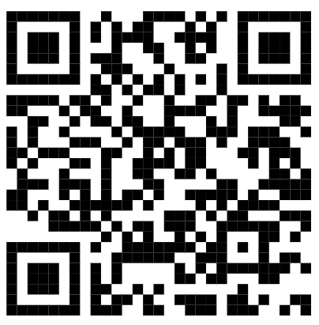
Software Requirements
Python Interpreter (version 3.8.5)
Python Editor (Pycharm or VS Code)
Github
https://zalo.me/g/ktiqwa611

Slide 19
Exercise 1
Create a repository for your group
Create a project in python:
adafruit-io
tensorflow
keras
Pillow
opencv-python
pyserial

